Slide 1


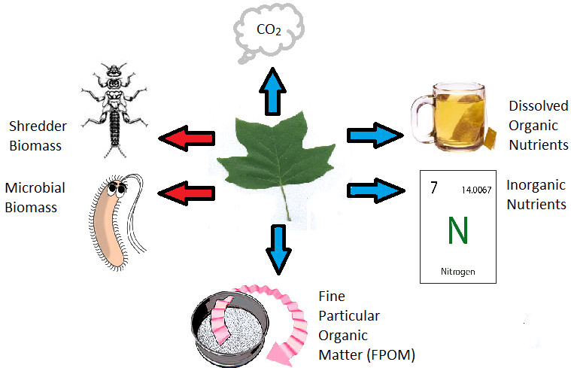
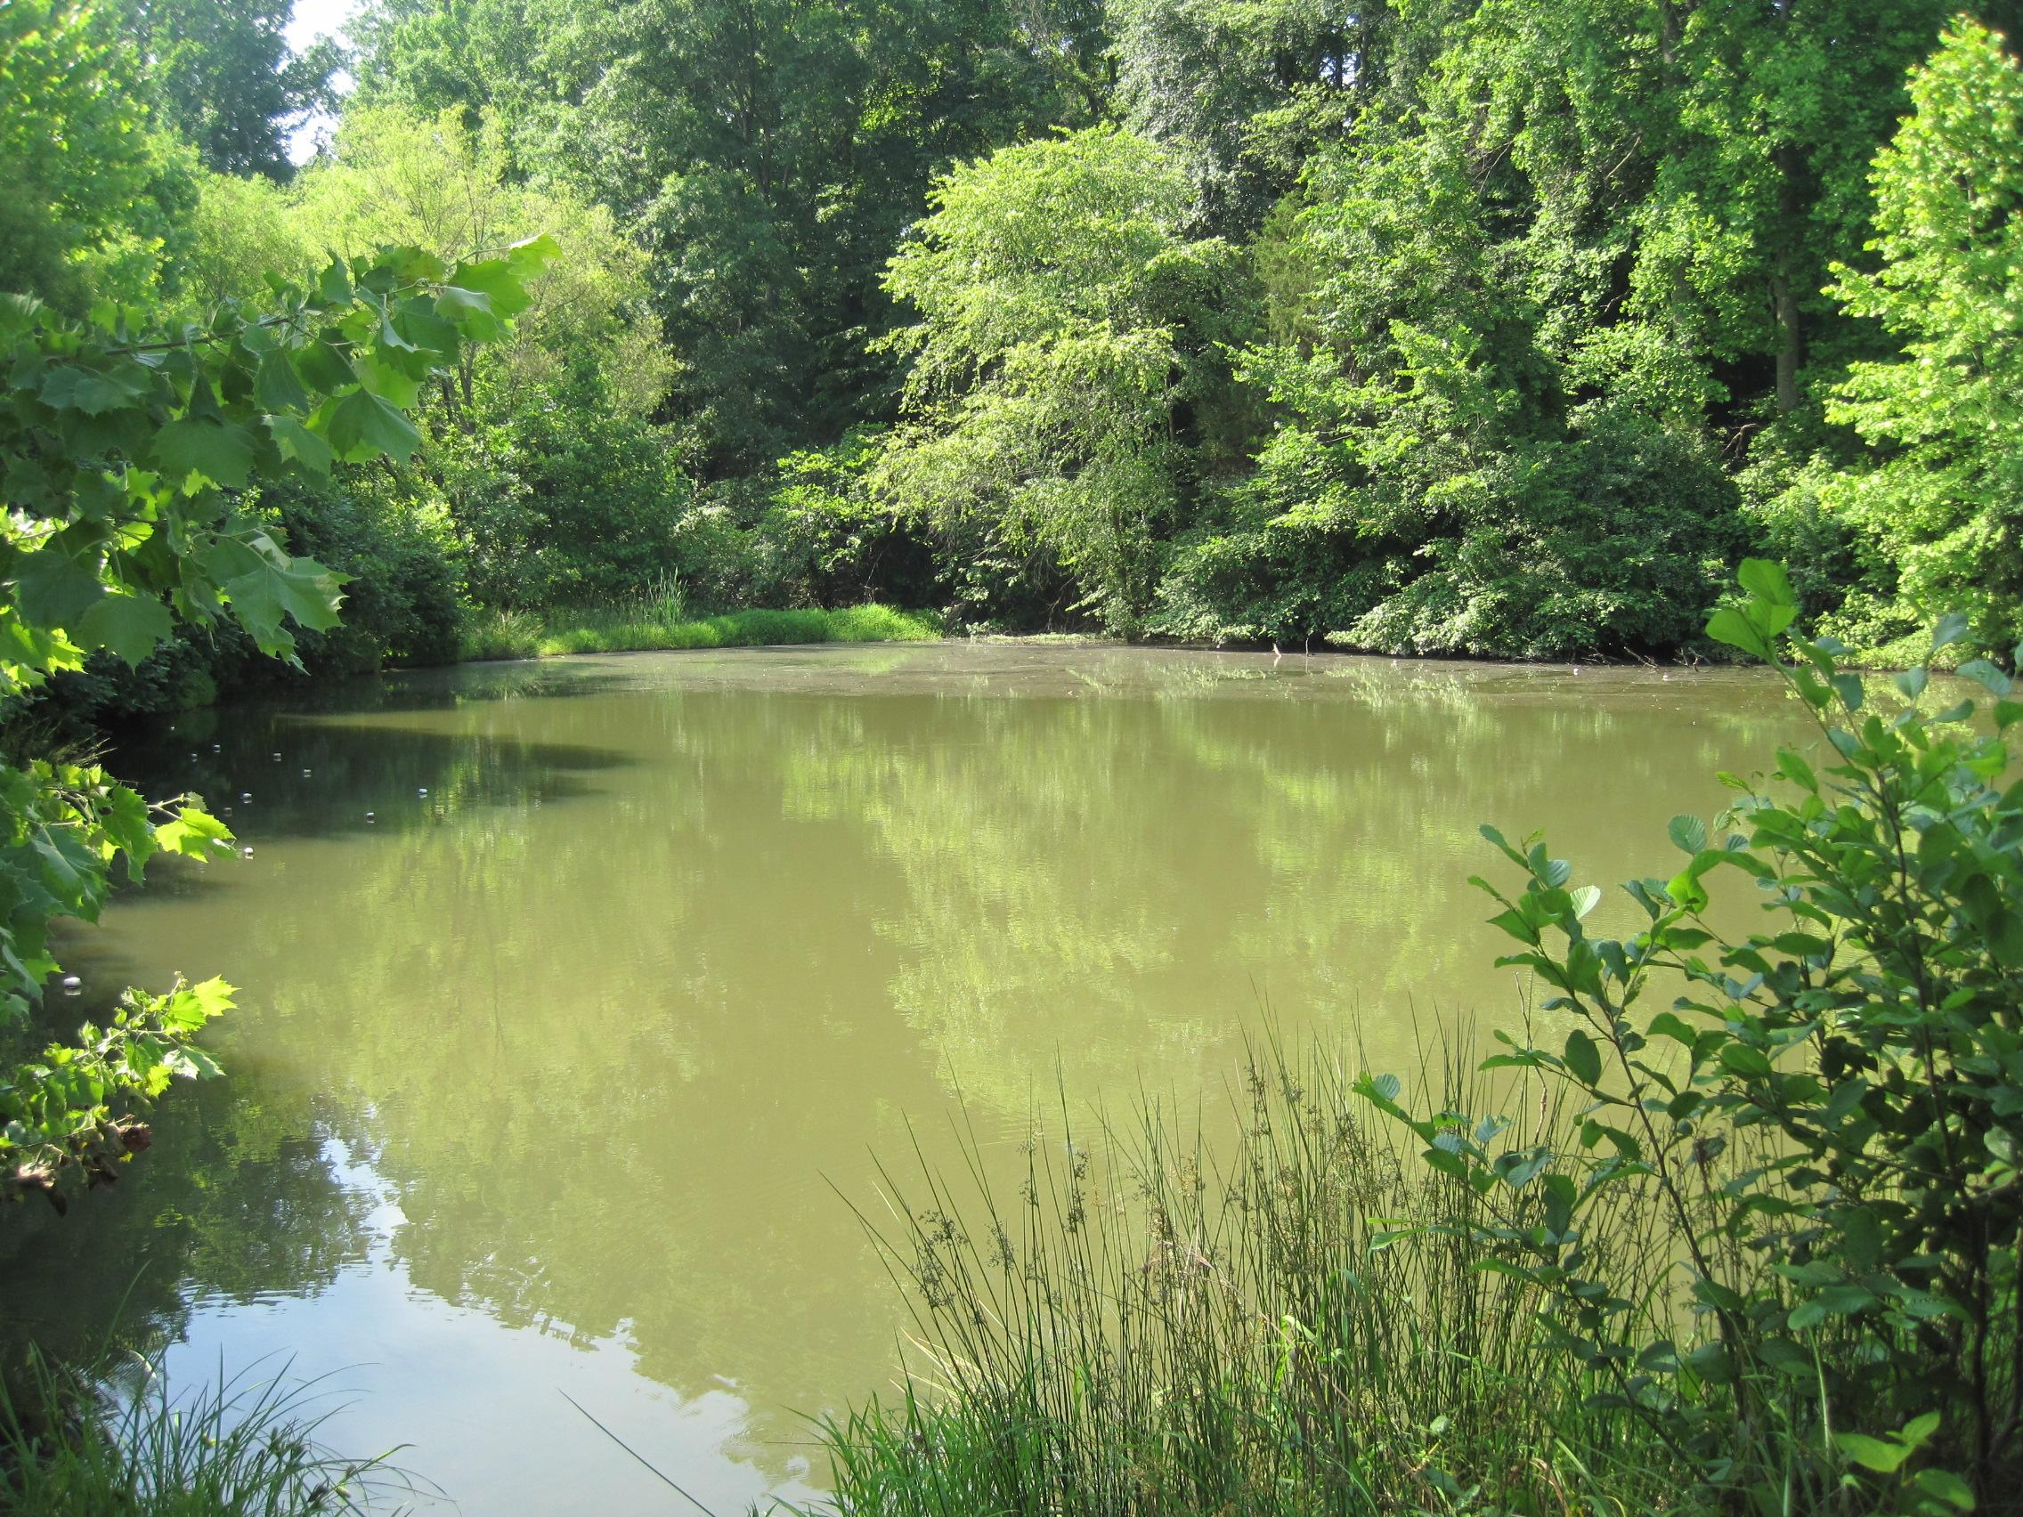
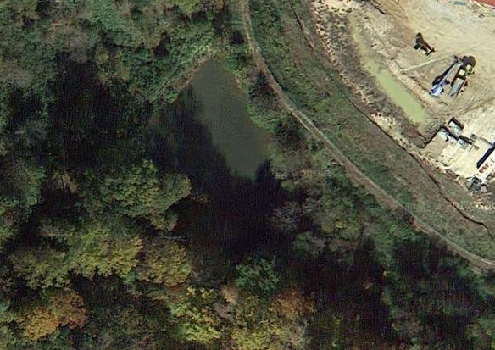
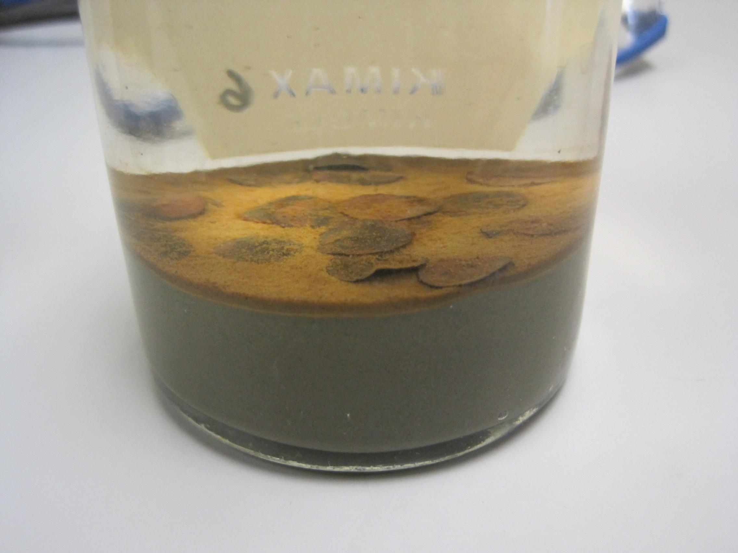
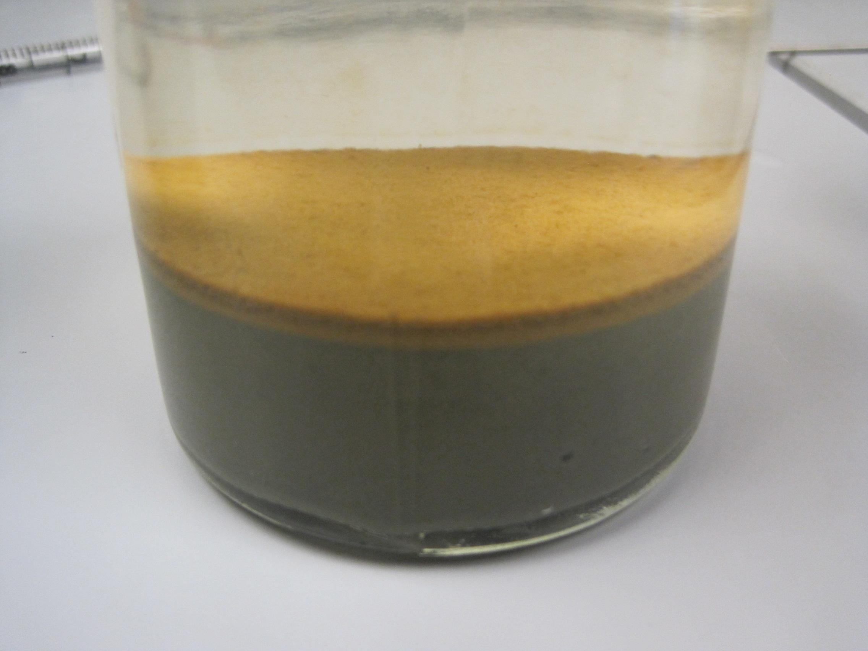
THE EFFECTS OF LEAF LITTER AND NUTRIENTS ON SEDIMENT OXYGEN DEMAND IN A MAN-MADE POND IN CENTRAL VIRGINIA
Kaitlyn D. Peters and Kenneth Fortino
Longwood University, Farmville, Va
Abstract
Results
On a global scale, the abundance and surface area of man-made ponds is nearly equal to that of natural ponds (Downing 2007). Despite this, little is known about the biogeochemical nutrient cycling of man-made ponds. Recent research suggests that leaf litter is an important resource in ponds because it is abundant, variable, and decomposes slowly (Fortino unpublished data). In order to better understand its significance, an experiment was devised that allowed us to simultaneously test the effects of leaf litter on sediment oxygen demand (SOD), and to see if leaf litter alters SOD in a nutrient enriched system. The experiment utilized a complete factorial design, with four BOD bottles for each treatment level. To perform the experiment, sediment samples were collected on 29 May 2014 and water samples on 9 June 2014 from a local, man-made pond, Lancer Park Pond. These samples were placed into 300 ml BOD bottles to mimic a man-made system, and then stored in a cool, dark place between sample runs. It was found that leaf litter, and to a lesser degree nutrient enrichment, increased overall sediment oxygen demand in the system. Spectrometry scans revealed that the labile organic matter greatly decreased in the leaf litter treatments, eventually stabilizing around the last two samples runs. Based on additional analyses, we also found evidence suggesting that the kind of organic matter introduced to the system was more important than the abundance.
Leaf Litter Effects
Nutrient Effects
Effects on OM Quality
Fate of Leaf Litter in Ponds
A comparison of the average sediment oxygen demand (SOD) in BOD bottles with and without leaf litter. Leaf litter significantly increases sediment oxygen demand in a the pond sediments. Note that, since these results were normalized by their organic matter content, the effect is not due to the increase in organic matter with the leaf additions.
A comparison of the average sediment oxygen demand (SOD) in BOD bottles with and without nutrient enrichment. Added nutrients significantly increases sediment oxygen demand in a the pond sediments. There was no significant interaction between leaf litter and nutrients, so the effect of nutrients was independent of the presence of leaf litter.
A comparison of the amount of labile dissolved organic matter over time in BOD bottles with and without leaf litter. The leaf litter resulted in an initial increase in the amount of labile dissolved organic matter but this effect did not persist past the first week of incubation,
Conclusions
What is the contribution of leaf litter to sediment oxygen demand in man-made ponds?
th
Does leaf litter affect sediment oxygen demand by altering the effects of nutrient enrichment?
Figure 1. Leaf litter that falls into ponds becomes coarse particulate organic matter (CPOM) in the sediments. The organic matter in the CPOM can be used as a food resource by shredding macroinvertebrates, and microbial (fungi and bacteria) communities (red arrows). The organic matter in the CPOM can also serve as a source of resources for organisms in the pond that do not use the CPOM directly (blue arrows). Soluble organic compounds leach from CPOM and produce dissolved organic matter. The consumption and metabolic activity of organisms using CPOM convert the CPOM mass into inorganic nutrients and CO₂, as well as fine particulate organic matter. (figure adapted from Gessner et al. 1999).
A comparison of the effect of leaf litter on sediment oxygen demand (SOD) in bottles over time. The SOD and the effect of leaf litter on SOD was greatest after 2 and 7 days of incubation and declined during the experiment. There was no significant effect of leaf litter on SOD after 21 days.
A comparison of the effect of added nutrients on sediment oxygen demand (SOD) in bottles over time. The SOD and the was greatest after 2 and 7 days of incubation and declined during the experiment but the effect of nutrients remains consistent for the 21 days of incubation.
Methods
Literature Cited
Acknowledgements
The combined effect of leaf litter and nutrient enrichment on sediment processes was tested with a complete factorial design design.
Each BOD bottle received 100 ml of sediment collected from Lancer Park Pond (Fig. 1) on 29 May, 2014 using an Eckman-dredge and sieved through 250 μm mesh.
The BOD bottles were then filled with Lancer Park Pond water collected 9 June 2014 from 0.5 m.
Nutrient enrichment treatments were created by adding 300 μg L⁻¹ of DIN and 30 μg L⁻¹ of DIP to the overlying water.
The leaf litter treatments were created by adding 20 leaf disks (10 mm diam.) to the BOD bottles (Fig. 2)
Sediment oxygen demand was determined using the Winkler’s Method (Carpenter 1965) on 5 dates.
The amount of labile organic matter in the overlying water was determined using the ratio of absorbance at 254 and 365 nm from a water sample filtered through a GFF on 5 dates.
Carpenter, J. H., 1965. The Chesapeake Bay Institute technique for the Winkler dissolved oxygen method. Limnology and Oceanography 10:144-143.
Gessner, M. O., Chauvet, E., and Dobson, M. 1999. A perspective on leaf litter breakdown in streams. Oikos 85:377-384.
We would like to thank Longwood University, the Longwood Real Estate Foundation, the Town of Farmville, and Daulton Farm for permission to sample the ponds. We would also like to thank the Longwood University PRISM program, the Longwood University Department of Biological and Environmental Sciences and the Cook Cole College of Arts and Sciences for funding.
Figure 1: Landscape and aerial views of Lancer Park Pond (LPP). LPP is a stormwater pond with a surface area of 0.06 ha and a maximum depth of 1.5m.
A
B
Figure 2: A. An example of a BOD bottle with CPOM present. B. An example of a BOD bottle without CPOM.

